Slide 1
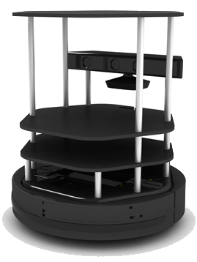
Medical Management Robot
Team member：Ren Yifei
Hu Ziqi
Yu Shizhuo
Zhang Jiashi

Slide 2
Vision Part
The robot takes a picture when the ‘/patient_reach’ topic arises.
The picture is analyzed by the Baidu AI system using online communication.
The Baidu AI system returns the keyword selected by the user, which includes the emotion analysis.
The analysis result is sent to WeChat, through which the nurses can obtain the state of the patient in real time.
Fig. 1. The flowchart

Slide 3
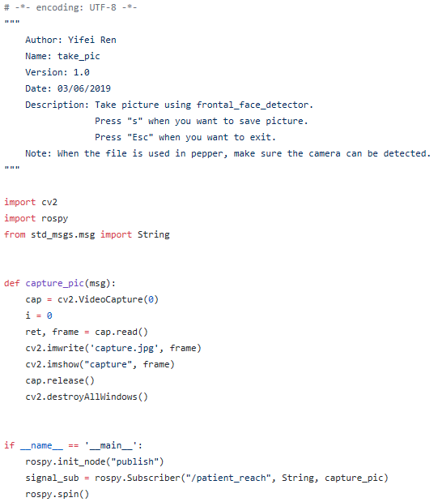
Vision Part
take_pic.py
Function:
Take picture when the ‘/patient_reach’ topic arises.

Slide 4
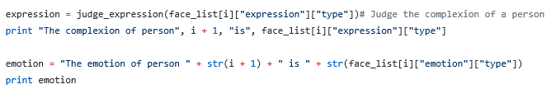
Vision Part
gender_predict.py
Function: Send the picture to Baidu AI API and get results.

Slide 5
Vision Part
take_pic.py
Function:
Take picture when the ‘/patient_reach’ topic arises.

Slide 6
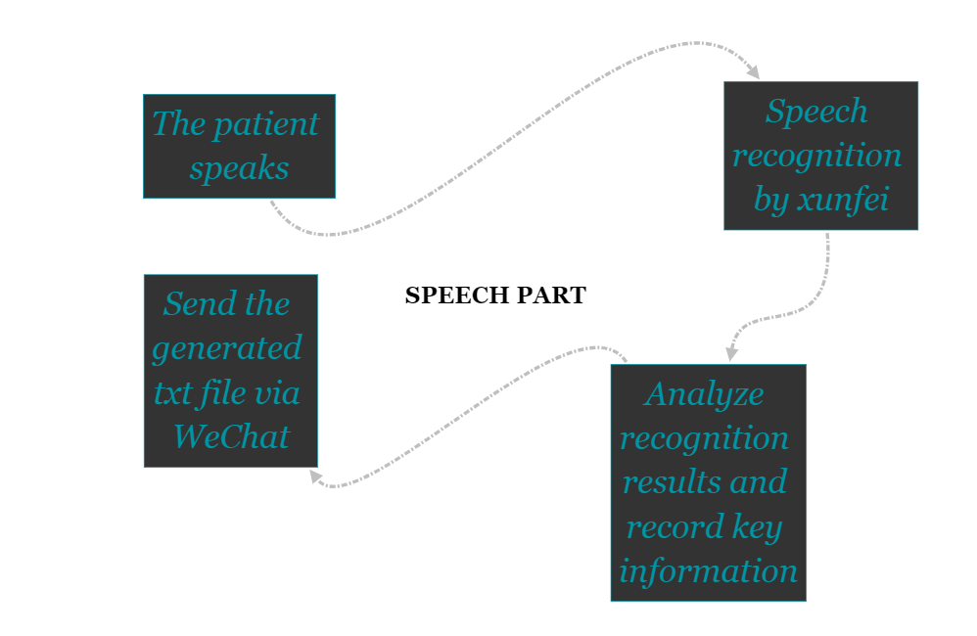
Speech Part
The frame:

Slide 7
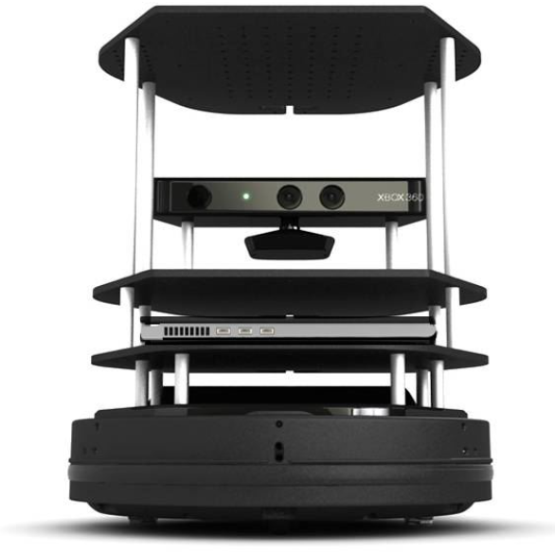
Speech Part
Technical Details:
Modify the xf_asr function package to recognize the voice heard every fifteen seconds, and publish the identified content in real time through the topic.
Build a subscriber to receive the received message and analyze it, record the physical information including body temperature and blood pressure, and generate a txt file.
Through the itchat package, the generated txt document is sent to the doctor remotely via WeChat to help him determine the patient's condition.

Slide 8
Navigation Part
Using Gmapping to build a map.
Using Map_server to load a map.
Using move_base to make a plan and control robot to move.
Using AMCL to localize autonomously.

Slide 9
ItChat
Laptop logs in with robot WeChat account.
Operator logs in with user’s WeChat account.
WeChat messages are translated into specific task content, and published into ROS topic.
Combined with navigation, image and speech, operator can utilize robot to check the patient’s condition and delivery medicines. The result will feed back through WeChat to the operator remotely.

Slide 10
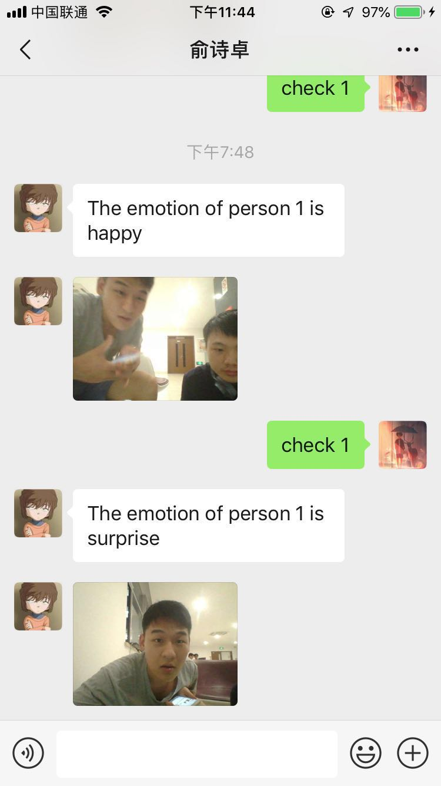
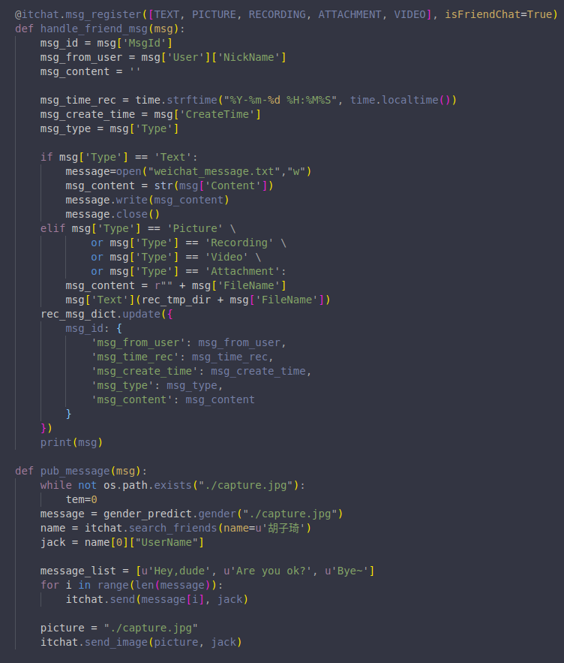
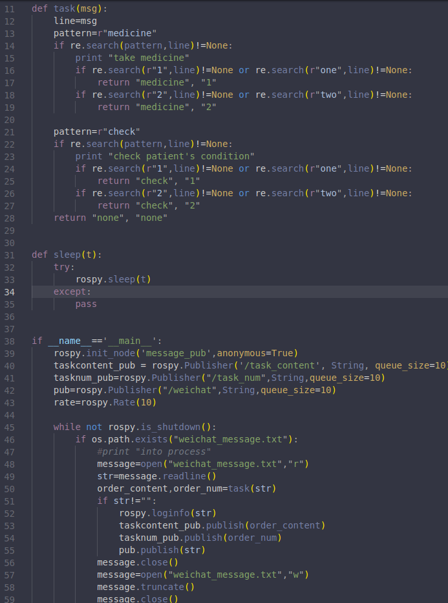
Experiment results

Slide 11
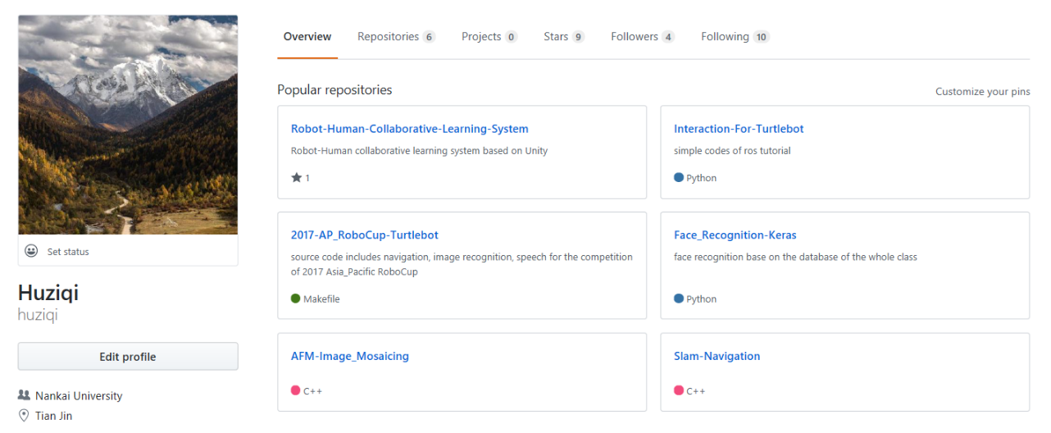
Welcome to follow my github

